Slide 1
CSC 131 Group Project
CSC 131 Group Two Project
Muhammad Ahmed
Anthony Chavez
Megan Householder
Kevin Huoth
Cameron Larson-Barrera
Sparashdeep Sidhu
Lizzeth Valencia

Slide 2
What We’ll Cover
Project Goal
Diagrams
SCRUM
Code
Demo

Slide 3
Project Goal
Pandemic and everyone needs to order takeout from local restaurants.
Need an easy and convenient way to order in a fashion that encourages social distancing for people that find that option preferable.
Promotes reuse through establishing a profile option.

Slide 4

Use Case Diagram

Slide 5
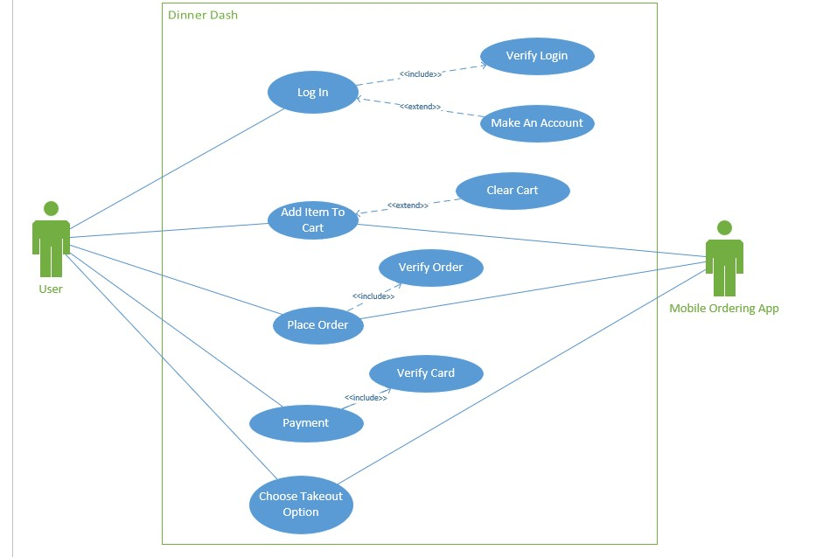

Slide 6

Sequence Diagram

Slide 7
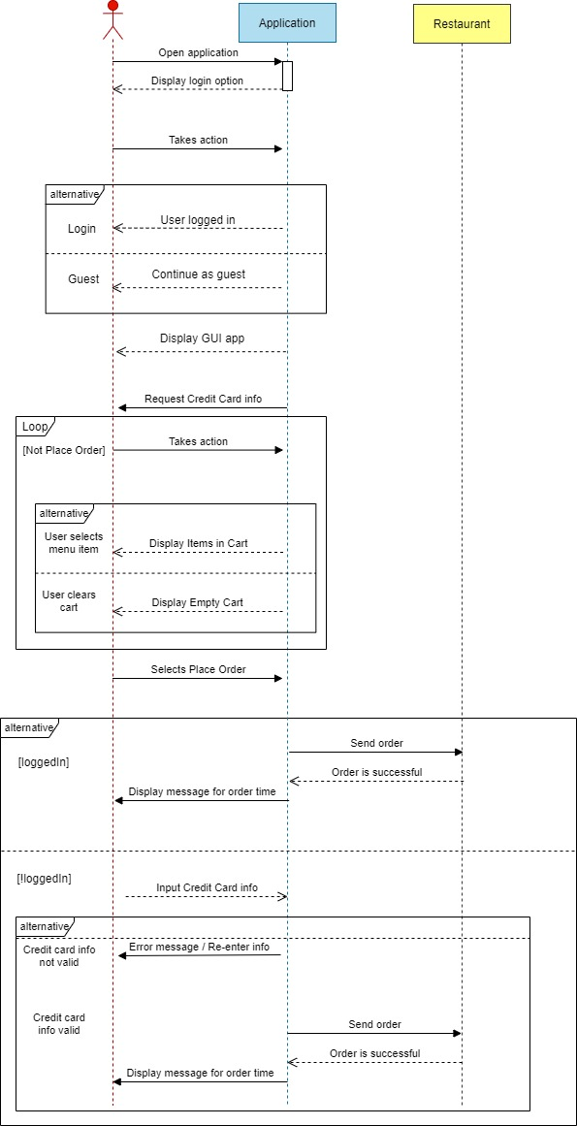
Part 1

Slide 8
Part 2

Slide 9
SCRUM
Sprints:
Two sprints that lasted 2 weeks long.
Daily status standups 2-3 times a week.
Sprint planning (beginning of sprint) and Sprint Review (end of sprint).
Sprint Review:
Development team members demo and describe the work they have done for the current sprint.
Allows team to ask questions, try new features, give feedback, and test acceptance criteria.
Team Roles:
SCRUM Master: Kevin Huoth
Product Owner: Muhammad Ahmed
Development Team: Anthony Chavez
Megan Householder
Cameron Larson-Barrera
Sparashdeep Sidhu
Lizzeth Valencia

Slide 10
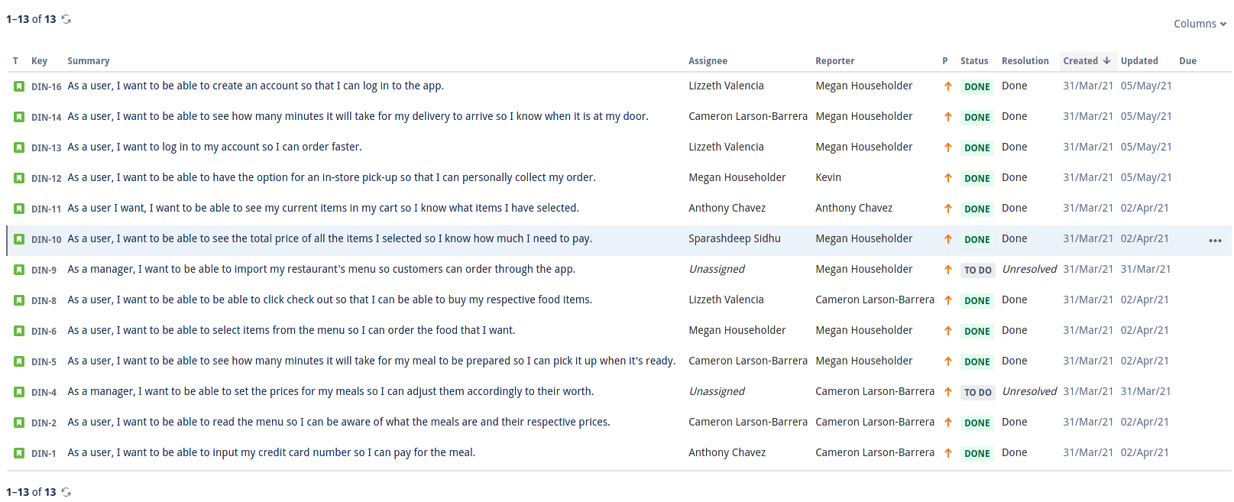
Sprint Backlog

Slide 11
Going Over The Code

Slide 12
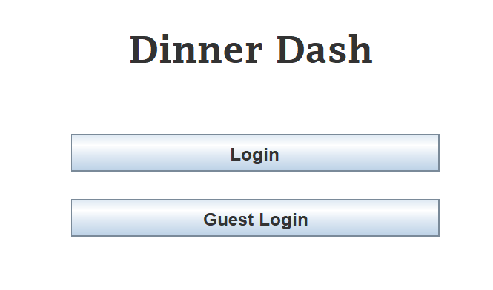
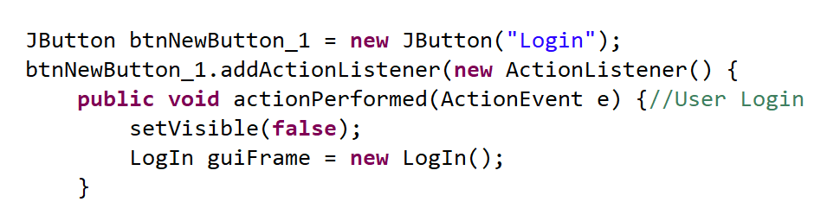
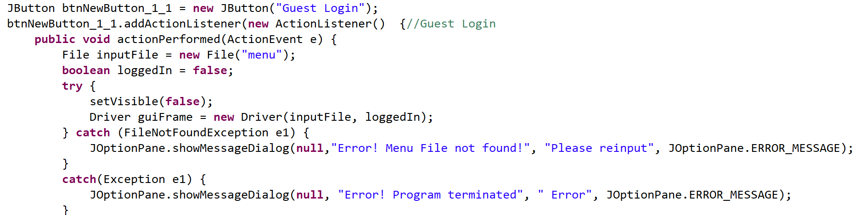
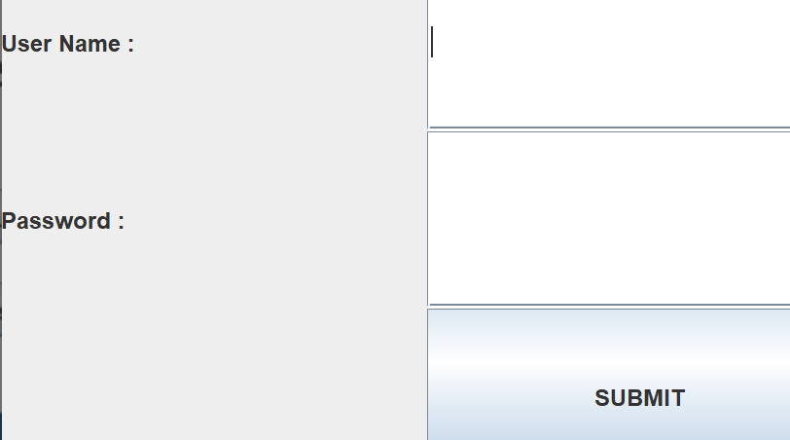
Log In
MainStart.java

Slide 13
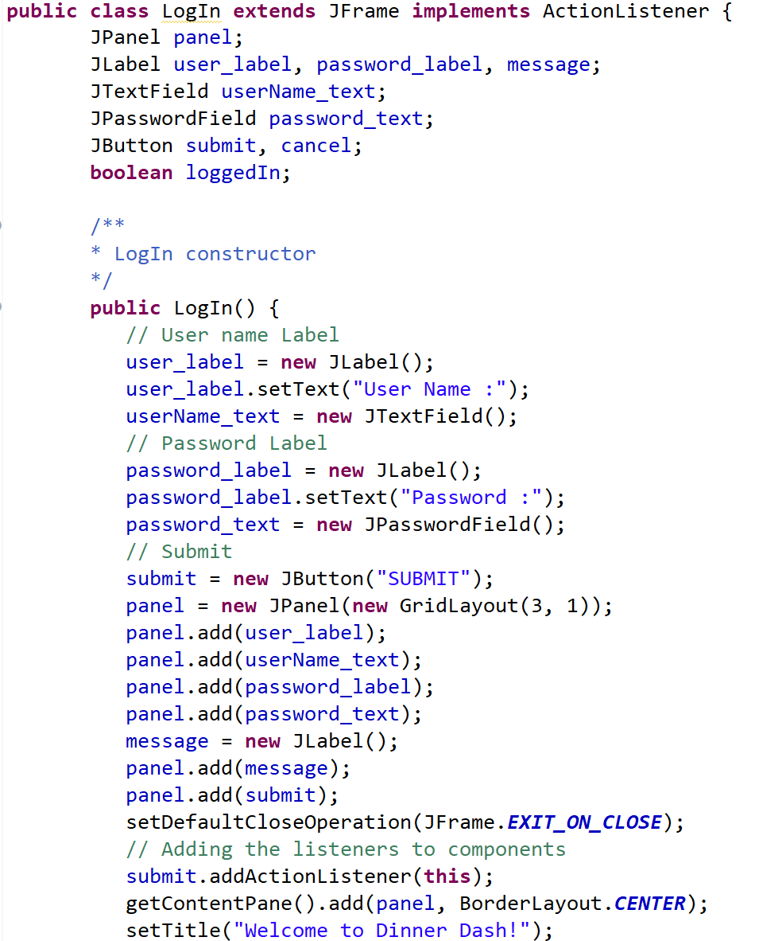
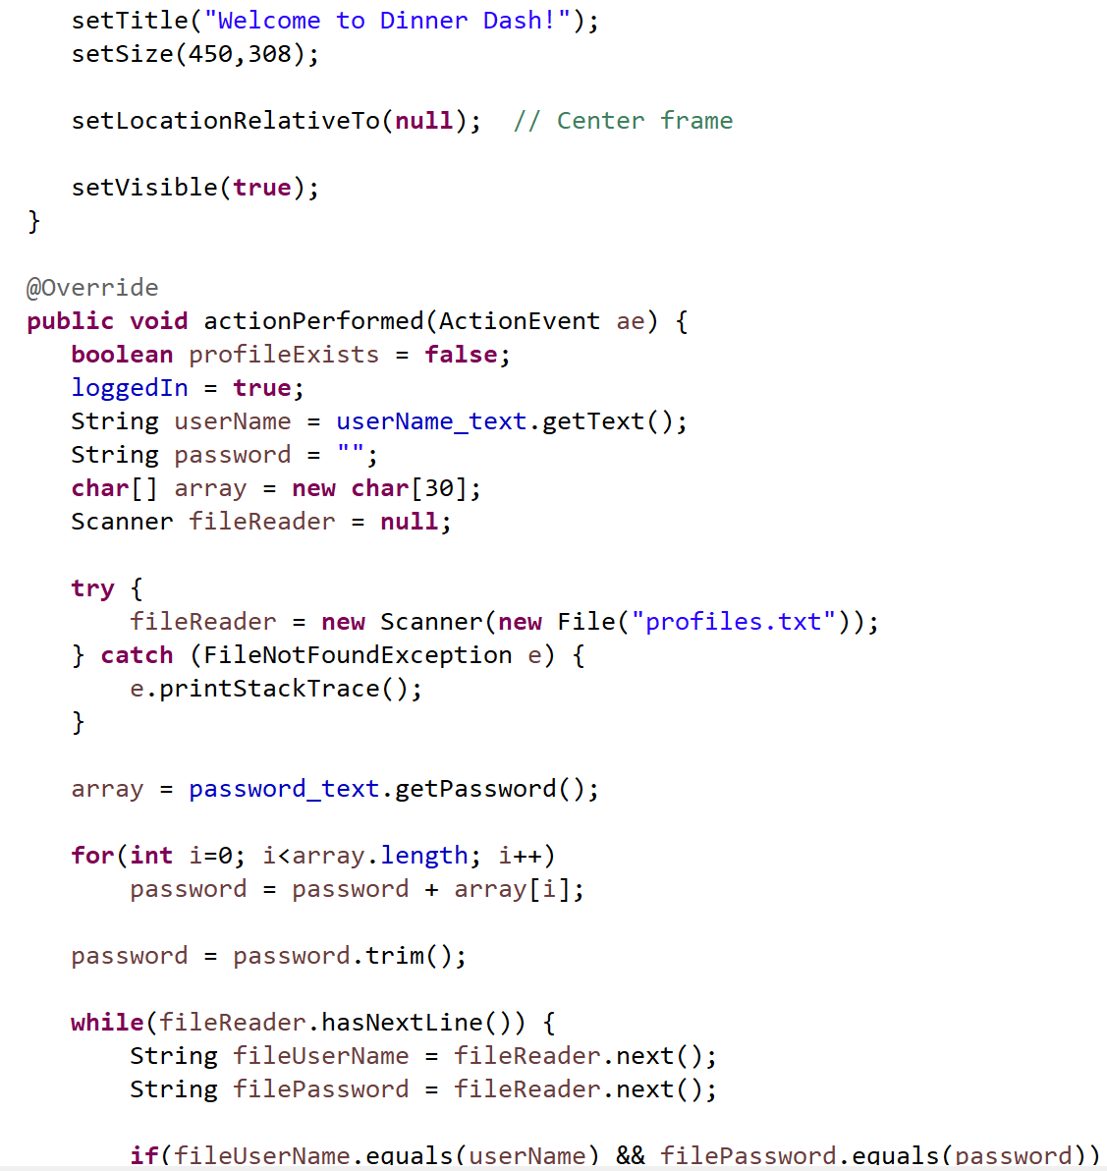
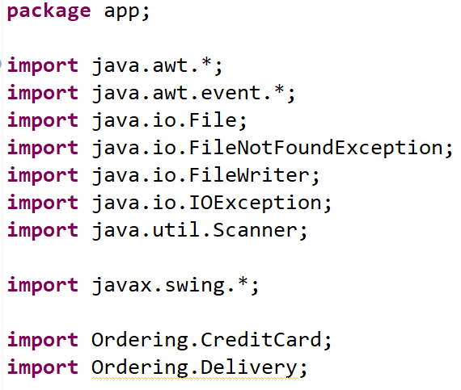
Log In
LogIn.java

Slide 14
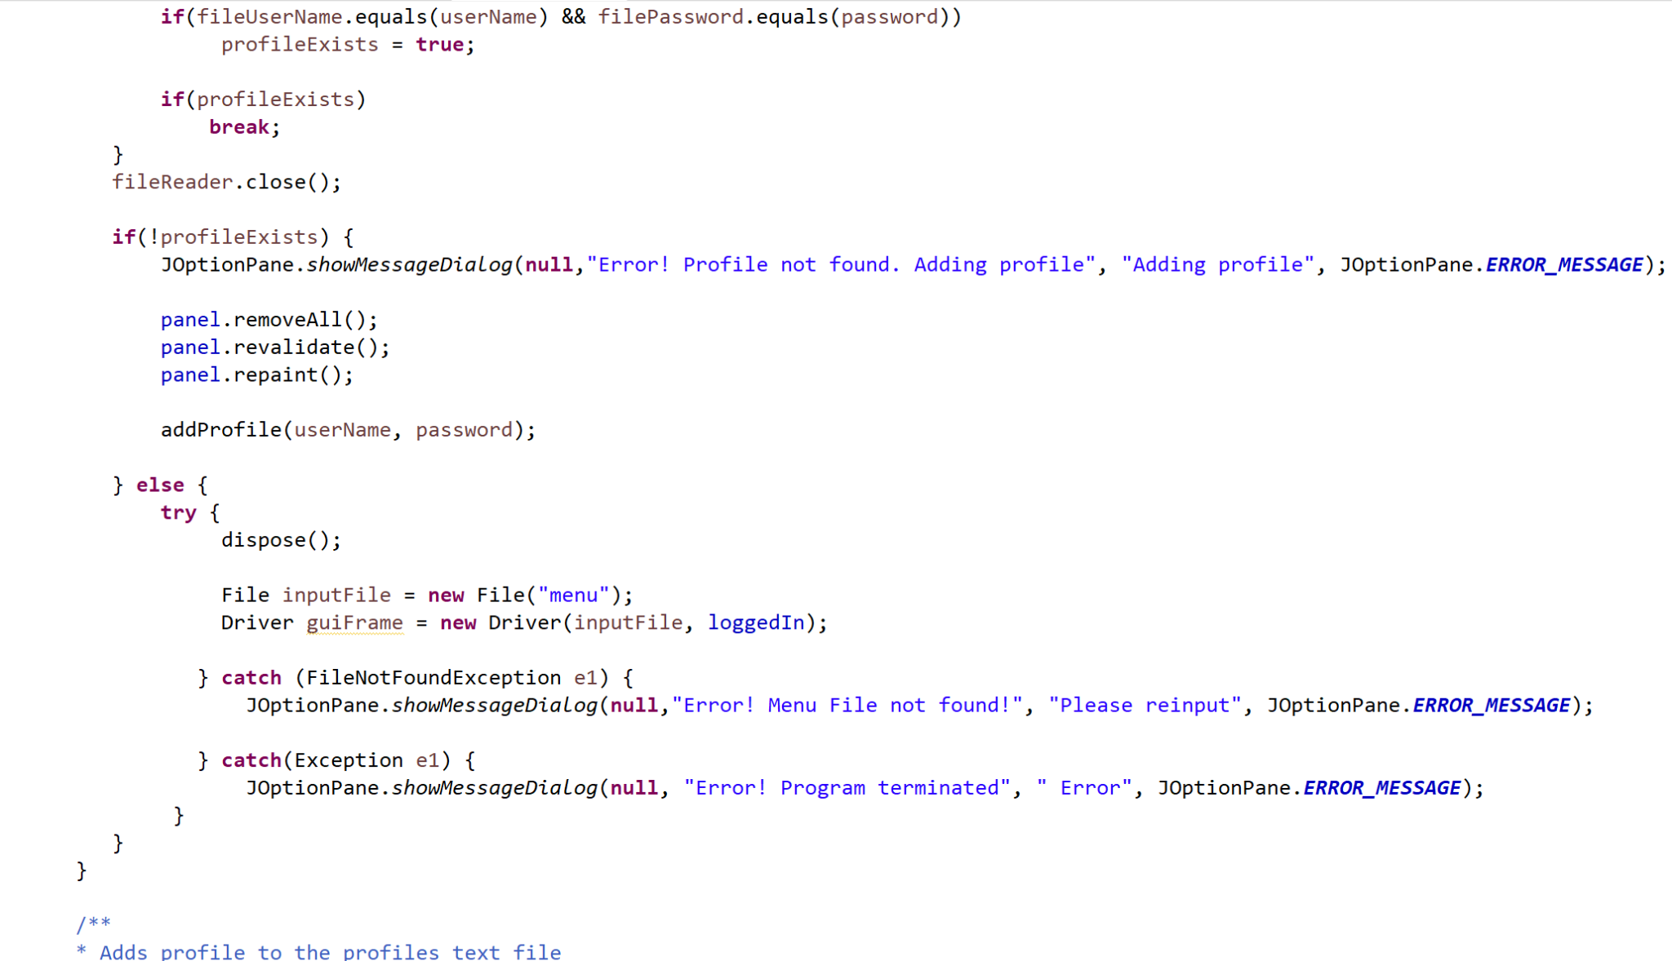
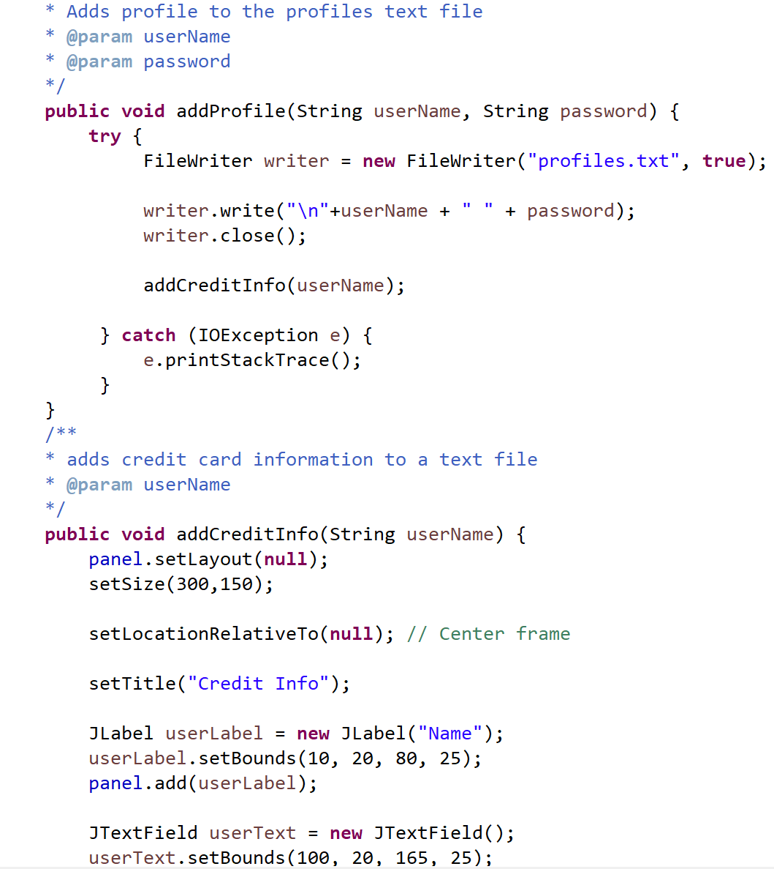
Create Profile

Slide 15
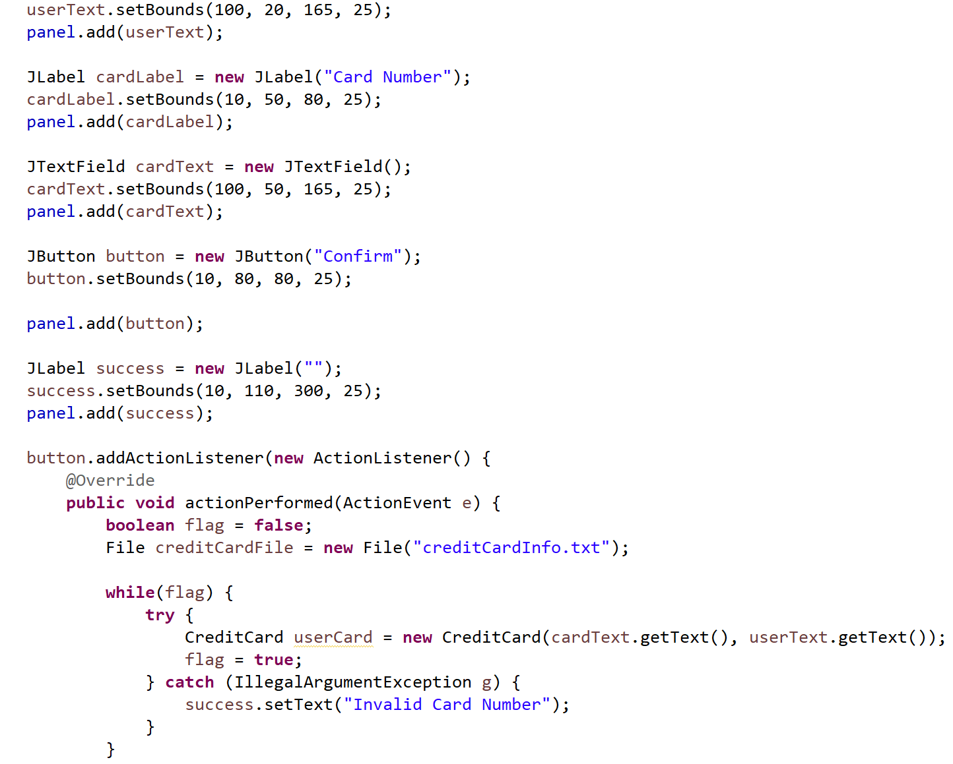
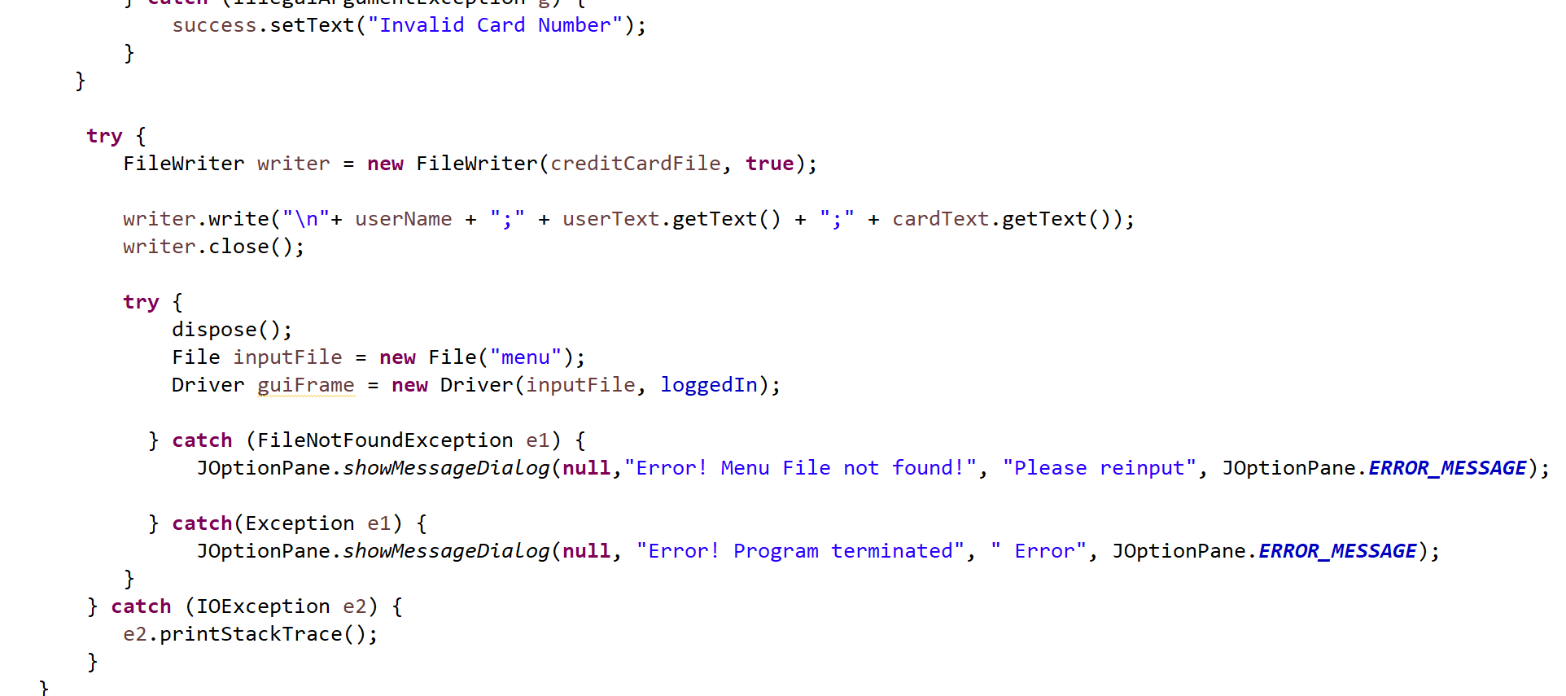
Create Profile

Slide 16
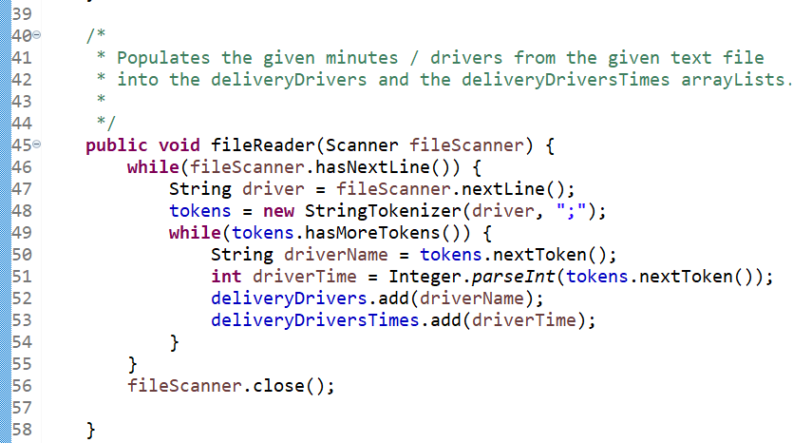
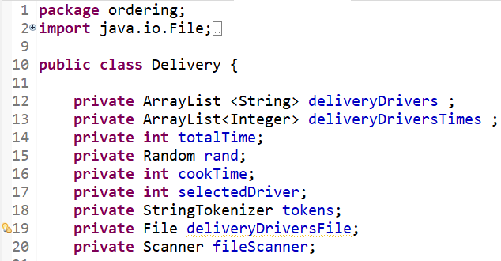
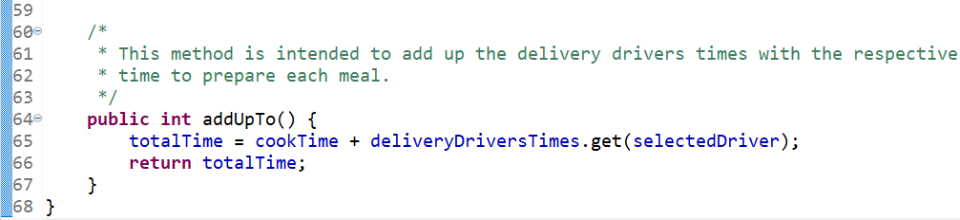
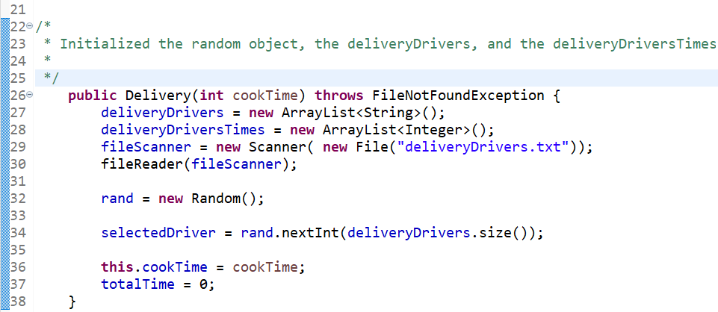
Delivery Driver

Slide 17
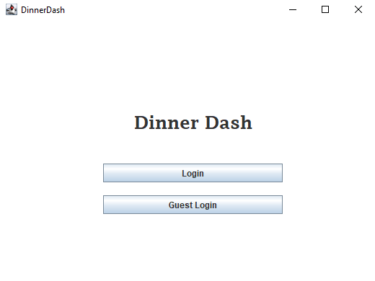
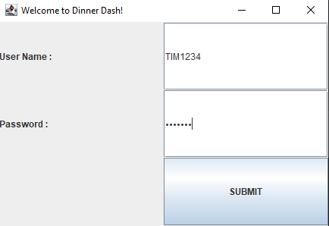
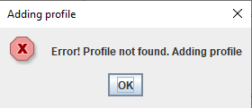
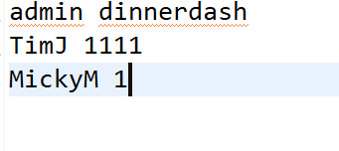
profiles.txt

Slide 18
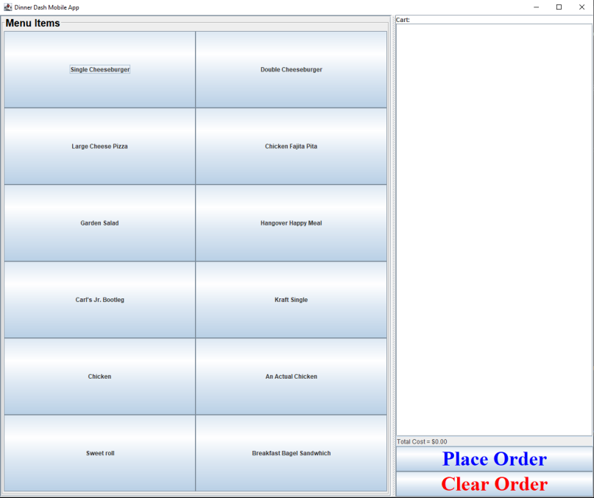

Slide 19
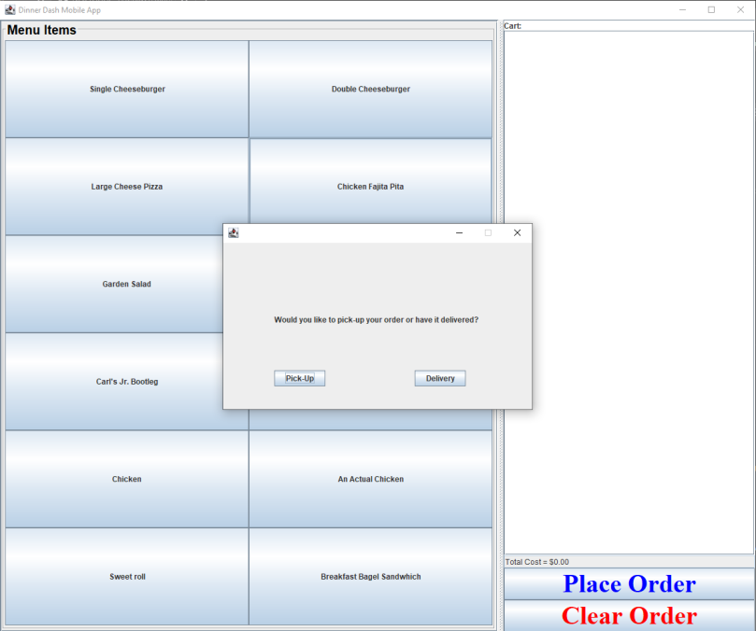
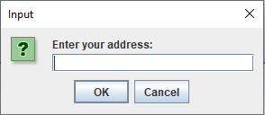
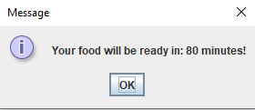
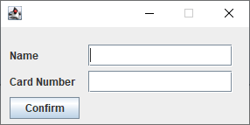

Slide 20
DEMO

